Slide 1
Core technologies - helm

Slide 2
Helm – A package manager for Kubernetes
What is a package manager?
Automates the process of installing, configuring, upgrading, and removing computer programs
Examples: Red Hat Package Manager (RPM), Homebrew, Windows Pkgmgr/PackageManagement
Helm enables multiple Kubernetes resources to be created with a single command
Deploying an application often involves creating and configuring multiple resources
A Helm chart defines multiple resources as a set
An application in Kubernetes typically consists of (at least) two resource types
Deployment – Describes a set of pods to be deployed together
Services – Endpoints for accessing the APIs in those pods
Could also include ConfigMaps, Secrets, Ingress, etc.
A default chart for an application consists of a deployment template and a service template
The chart creates all of these resources in a Kubernetes cluster as a set
Rather than manually having to create each one separately via kubectl
Notes:
Helm is a package Manager
Automates the installation, configuration, upgrade and removing of Apps
Deploys the App and its Configuration
The App and its Config are packaged in a so called Chart
At least two resource types: Deployment and Services (Secrets, ConfigMap)
You avoid creating each resource manually using kubectl

Slide 3

Helm Terminology
Helm – The CLI
Helm installs charts into Kubernetes, creating a new release for each installation
To find new charts, search Helm chart repositories
Chart – The application package
Templates for a set of resources necessary to run an application
The chart includes a values file that configures the resources
Repository – The library
Storage for Helm charts
stable – The namespace of the hub for official charts
Release – The application runtime
An instance of a chart running in a Kubernetes cluster
The same chart installed multiple times creates many releases
Tiller – The server-side engine
Helm templating engine, runs in a pod in a Kubernetes cluster
Tiller processes the chart to generate the resource manifests, then installs the release into the cluster
Tiller stores each release as a Kubernetes config map
Chart (templates)
Values (config)
install
Kubernetes cluster
Release
(resources)
Tiller
Notes:
Helm is the CLI
Helm creates a new release for each installation (versioning: rollback)
Chart is the application package
Repository is the library: Just a web server
Release is the application runtime: An instance of a Chart
Tiller is the server side. Runs in a pod.

Slide 4
Advantages of Using Helm
Deploy all of the resources for an application with a single command
Makes deployment easy and repeatable
$ helm install <chart>
Separates configuration settings from manifest formats
Edit the values without changing the rest of the manifest
values.yaml – Update to deploy the application differently
Upgrade a running release to a new chart version
$ helm upgrade <release> <chart>
Rollback a running release to a previous revision
$ helm rollback <release> <revision>
Delete a running release
$ helm delete <release>
Kubernetes cluster
Chart
myapp v1
install
Release
myapp r1
upgrade
rollback
Chart
myapp v2
(upgrade)
Release
myapp r2
delete
Notes:
Deploy all resources with a single command
Can use variables to deploy same App with new parameters
Upgrade to a new version of your chart
Rollback
Delete as a whole

Slide 5
Creating a Chart
Creating a new chart generates a directory with sample files
$ helm create my-chart $ tree my-chart
my-chart/ # The content of this directory is the chart |- Chart.yaml # Information about the chart |- values.yaml # The default configuration values for this chart |- charts/ # Charts that this chart depends on |- templates/ # This chart's template files |- NOTES.txt # OPTIONAL: A plain text file containing short usage notes |- _helpers.tpl # OPTIONAL: The default location for template partials |- deployment.yaml # Sample template for a deployment resource |- service.yaml # Sample template for a service resource
Chart starts with sample templates for a Kubernetes deployment and service
In the simplest case, just edit the values.yaml file
Notes:
Create a new chart using helm create my-chart
Go Language
The Chart starts with a sample template for a Kube deployment and service
You can start with editing values,yaml

Slide 6
Packaging Charts
A chart is a directory
Easy for a Helm client to use the chart directories on the same computer
Difficult to share with other users on other computers
Packaging a chart
Bundle Chart.yaml and related files into a tar file
$ helm package <chart-path> # Bundles chart directory into a tar file
$ helm install <chart-name>.tgz # Installs the chart in the chart file
Packaged charts can be shared in a chart repository
Sub-charts:
Chart can reference other charts using requirements.yaml file, these sub-charts will be installed with the current chart
Notes:
A chart is a directory
Is usually on a web server so you can share charts with others
Is called chart repository
You can package a chart into a tar file

Slide 7
Installing an Application
To deploy an application into Kubernetes, install that application’s Helm chart
$ helm search mysql
NAME VERSION DESCRIPTION stable/mysql 0.1.1 Chart for MySQL
$ helm install stable/mysql
Fetched stable/mysql to mysql-0.1.1.tgz NAME: loping-toad LAST DEPLOYED: Thu Oct 20 14:54:24 2016 NAMESPACE: default STATUS: DEPLOYED
RESOURCES: ==> v1/Secret NAME TYPE DATA AGE loping-toad-mysql Opaque 2 3s
==> v1/Service NAME CLUSTER-IP EXTERNAL-IP PORT(S) AGE loping-toad-mysql 192.168.1.5 <none> 3306/TCP 3s
==> extensions/Deployment NAME DESIRED CURRENT UP-TO-DATE AVAILABLE AGE loping-toad-mysql 1 0 0 0 3s
==> v1/PersistentVolumeClaim NAME STATUS VOLUME CAPACITY ACCESSMODES AGE loping-toad-mysql Pending
Install output
Details about the release
Details about its resources
Chart
stable/mysql
Release name
loping-toad (auto generated)
Resources
Four total, one of each type
All named loping-toad-mysql
Secret
Service
Deployment
PersistentVolumeClaim
Notes:
Search for a chart with helm search
Deploy a chart with helm install
See the resources created

Slide 8
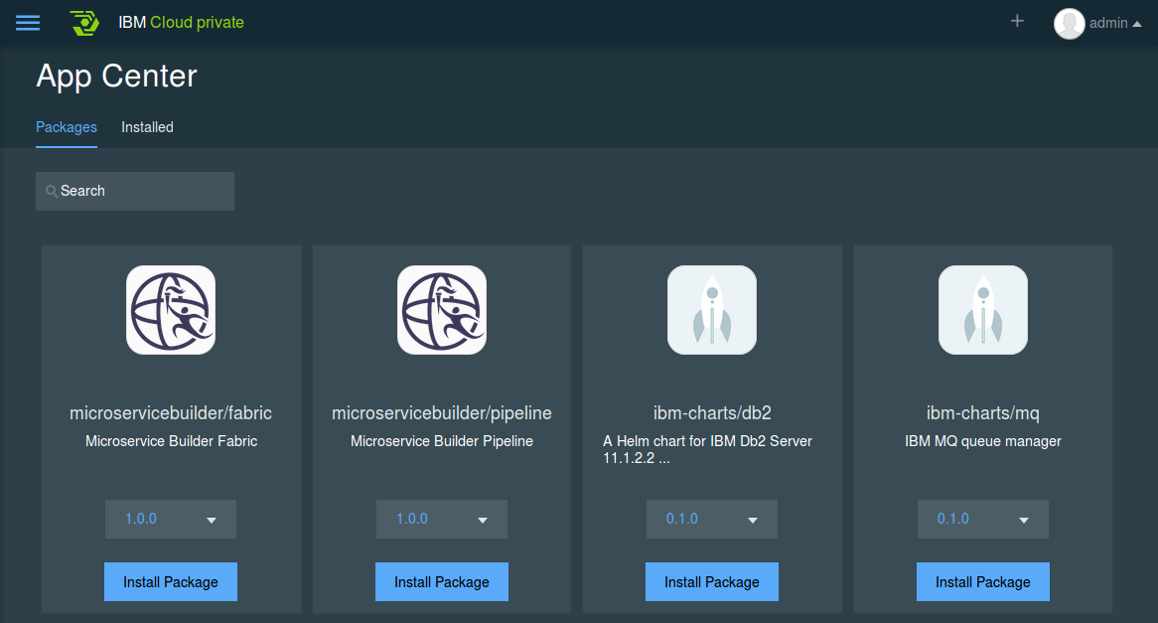
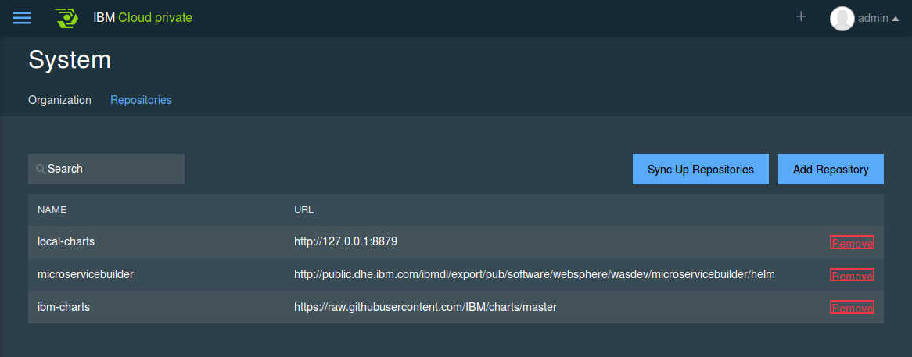
Helm and IBM Cloud Private
AppCenter entries are helm charts that can be deployed from the chart repositories.
Notes:
The App Catalog contains Helm Charts from Chart Repositories

Slide 9
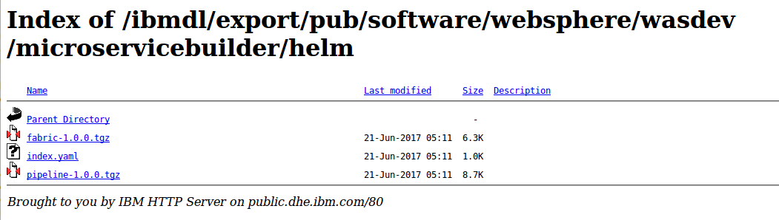
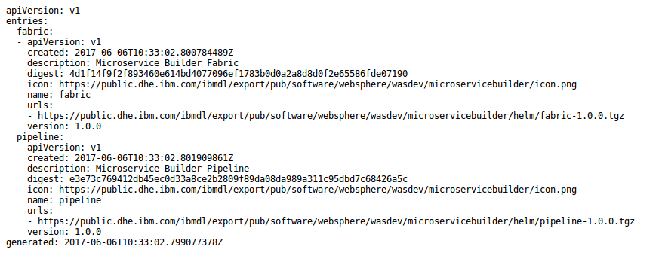
Chart repository
Chart repository:
HTTP server that houses an index.yaml file and optionally some packaged charts
Server can be any HTTP server that can serve YAML and tar files and can answer GET requests
To serve a local repo
$ helm serve
To add a chart to the repository, copy it to the directory and regenerate the index
$ helm repo index <charts-path>
Notes:
Chart repository is a web server with an index.yaml file
There are steps for adding a chart to a repository: copy, reindex
Also for the local repository in ICP
Adding your chart to local-repo:
on master, get helm container using `docker ps | grep helm`
copy your chart using `docker cp x.tar.gz <dockerID>:/local-repo`
Restart the container using docker restart <helm container id>
go to dashboard, click sync up repo, you will get your chart in app center

Slide 10
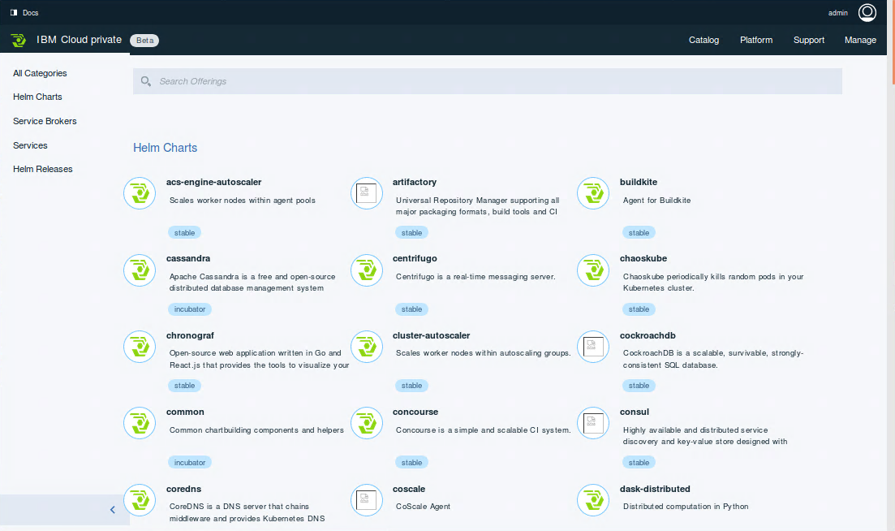
IBM Cloud Private catalog
https://<master>:8443/catalog
Notes:
Here is a sample catalog

Slide 11
Resources – Introduction
Helm - The Kubernetes Package Manager
https://helm.sh
https://docs.helm.sh
https://github.com/kubernetes/helm
https://github.com/kubernetes/helm/blob/master/docs/index.md
Taking the Helm: Delivering Kubernetes-Native Applications by Michelle Noorali (KubeCon 2016)
https://www.youtube.com/watch?v=zBc1goRfk3k
Installing Helm
https://docs.helm.sh/using_helm/#installing-helm
Notes:
Resources

Slide 12
Resources – Developing Charts
Helm examples
https://github.com/kubernetes/helm/tree/master/docs/examples
Stable Helm charts
https://github.com/kubernetes/charts/tree/master/stable
Golang templates
https://golang.org/pkg/text/template
Spring template library
https://godoc.org/github.com/Masterminds/sprig
Getting Started Authoring Helm Charts
https://deis.com/blog/2016/getting-started-authoring-helm-charts
How to Create Your First Helm Chart
https://docs.bitnami.com/kubernetes/how-to/create-your-first-helm-chart
Packaged Kubernetes Deployments – Writing a Helm Chart
https://www.influxdata.com/packaged-kubernetes-deployments-writing-helm-chart
Notes:
Examples of Helm Charts and Golang templates
So you can build your own charts
Or stable charts to use

Slide 13
WebSphere Liberty on IBM Cloud Private

Slide 14
Deploying an application to IBM Cloud Private
Deploying an application to a IBM Cloud Private environment involves the following key tasks:
Build a Docker image with the application deployed with in
Run and verify the Docker image locally
Push the Docker image into the IBM Cloud Private Docker registry
Run the Docker image in IBM Cloud Private environment
Expose the running container for external access
Verify and test the application

Slide 15
Deploying an application to IBM Cloud Private
Deploying an application to a IBM Cloud Private environment involves the following key tasks:
Build a Docker image with the application deployed with in
Run and verify the Docker image locally
Push the Docker image into the IBM Cloud Private Docker registry
Run the Docker image in IBM Cloud Private environment
Expose the running container for external access
Verify and test the application
The most important step for WebSphere-based workloads!

Slide 16
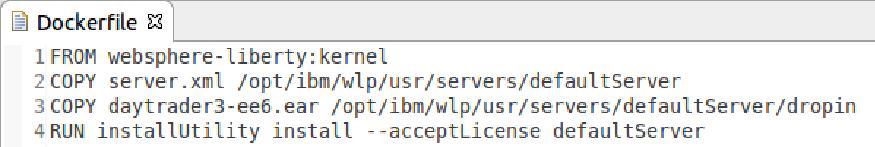
Building a Docker image for IBM Cloud Private (1 of 3)
Step 1: Create a Dockerfile
FROM: Base image for the new image. IBM has published an official set of foundational Docker images containing IBM products, such as WebSphere Liberty
Dockerfile: A text file containing Docker image building instructions
COPY: Instruction to copy a configured server.xml file to the Liberty server in the base image
COPY: Instruction to copy an application deployable to the Liberty server’s dropin folder in the base image
RUN: Execute shell commands to install all required Liberty features
COPY: You may also copy a configured Liberty server with your application deployed as a whole.
Alternate

Slide 17
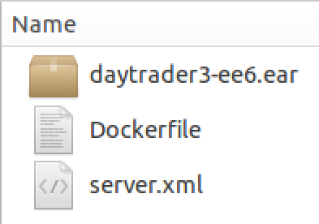
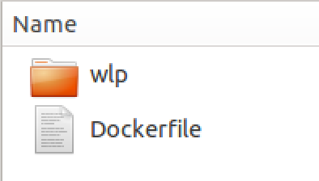
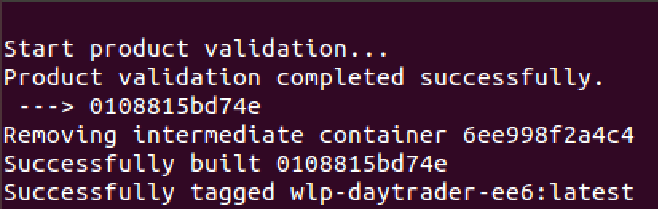
Building a Docker image for IBM Cloud Private (2 of 3)
Step 2: Prepare deployable artifacts
Copy all files required in Dockerfile into a temporary deployment directory including the Dockerfile itself. This minimized the number of files pushed to the Docker daemon.
Copy the configured Liberty server folder into the temporary deployment folder if doing the whole server push.
Alternate
Step 3: Run Docker CLI build command
docker build -t wlp-daytrader-ee6 .
Build Result
-t <tag_name>: creates a tag for your own custom image. Tags are used for versioning and registry specification.
<context_path>: root directory where all source artifacts specified in the Dockerfile are located.

Slide 18
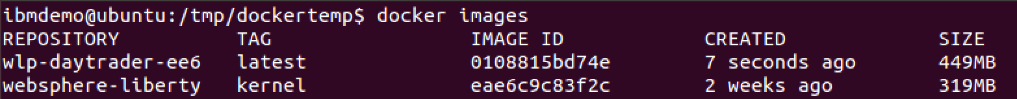
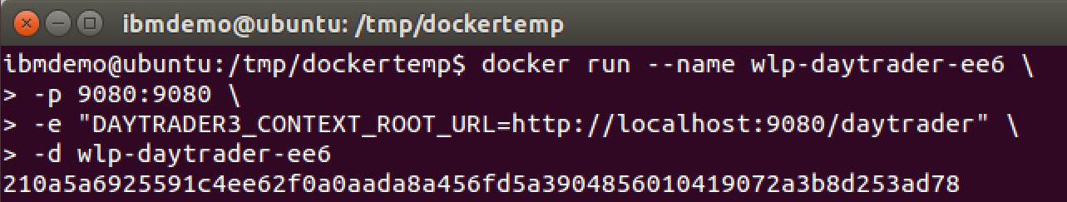
Building a Docker image for IBM Cloud Private (3 of 3)
Step 4: View Docker image(s)
docker images
Step 5: Run Docker image
docker run --name wlp-daytrader-ee6 –p 9080:9080 –d wlp-daytrader-ee6
--name: the name you wish to assign to the container.
-p: publish a container port to a host port. In this case port 9080 on the container will be available to the host using port 9080
-d: detach the container to run in the background and print the container id.
Docker image to run

Slide 19
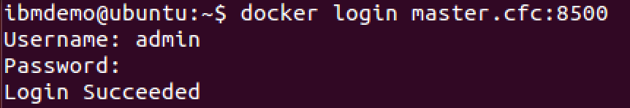
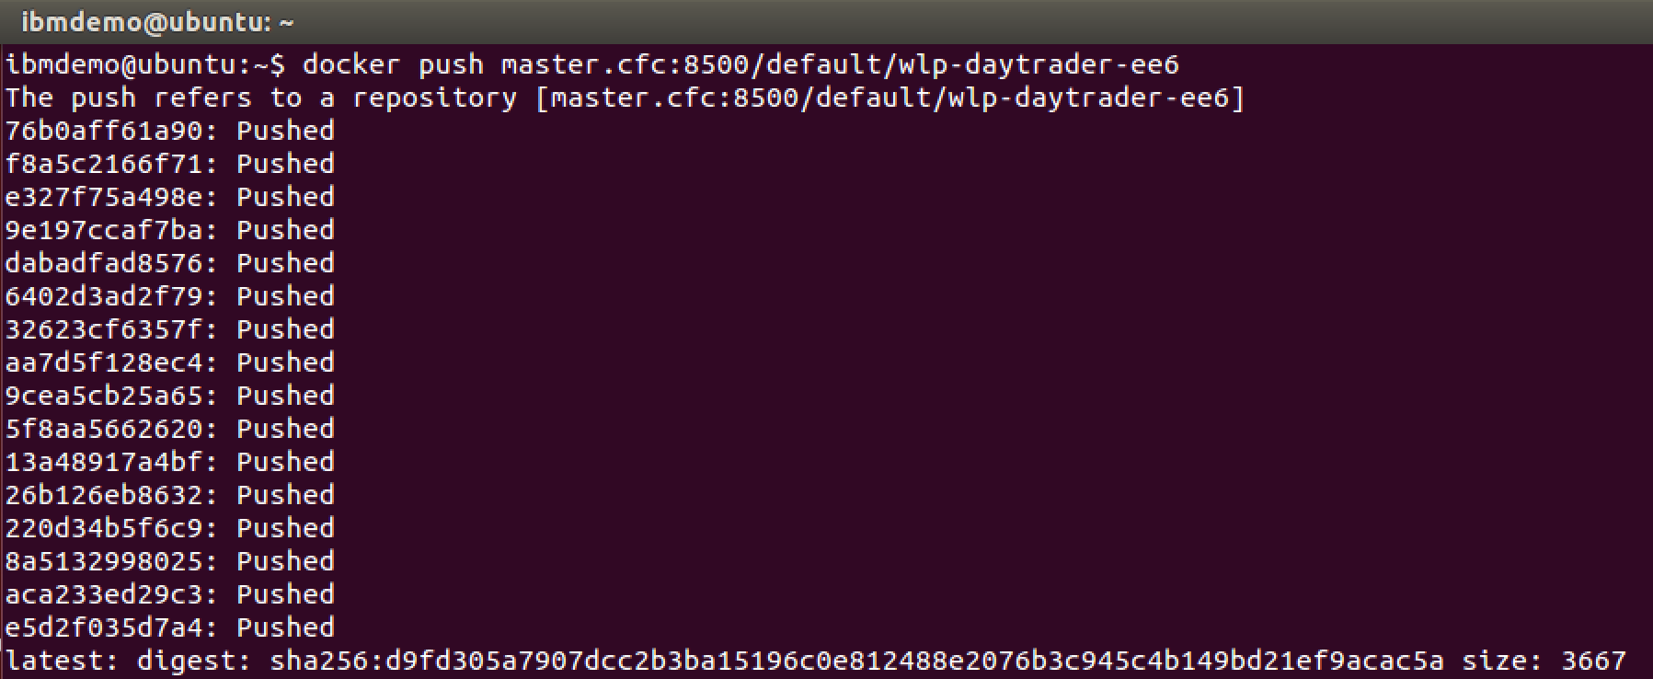
Deploying a Docker image to IBM Cloud Private (1 of 8)
Step 1: Login to IBM Cloud Private
docker login <cloud_private_host:port>
Step 2: Tag image with IBM Cloud Private Docker registry information
docker tag wlp-daytrader-ee6 <cloud_private_host:port>/default/wlp-daytrader-ee6
Step 3: Push image to IBM Cloud Private Docker registry
docker push <cloud_private_host:port>/default/wlp-daytrader-ee6

Slide 20
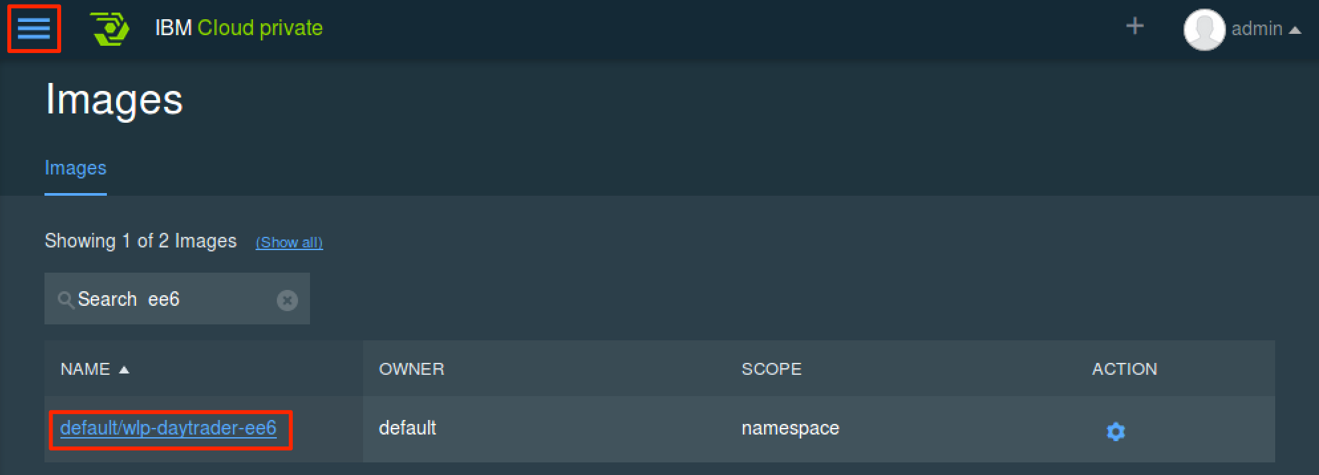
Deploying a Docker image to IBM Cloud Private (2 of 8)
Step 4: Verify image push in IBM Cloud Private dashboard
Go to Menu → Infrastructure → Images

Slide 21
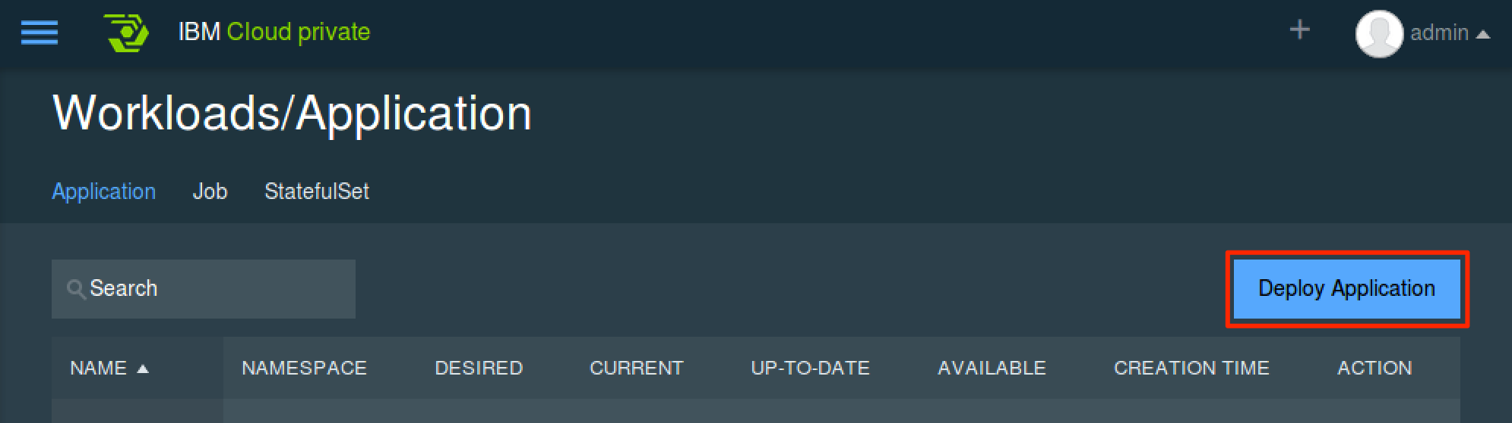
Deploying a Docker image to IBM Cloud Private (3 of 8)
Step 5: Initiate application deployment
Go to Menu → Workloads → Applications
Click Deploy Application to initiate application deployment

Slide 22
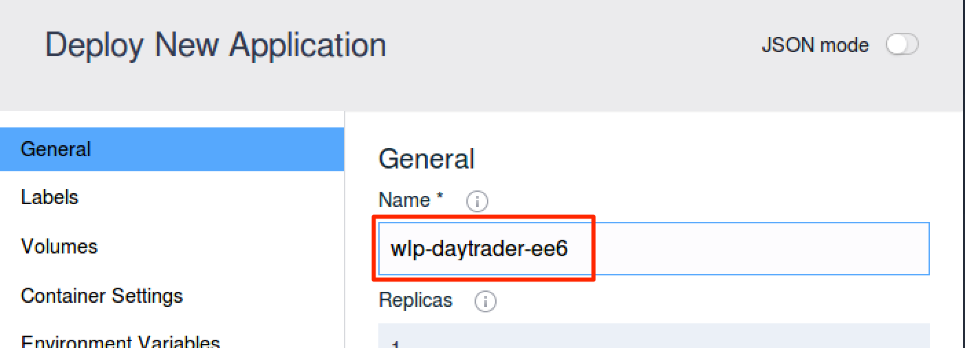
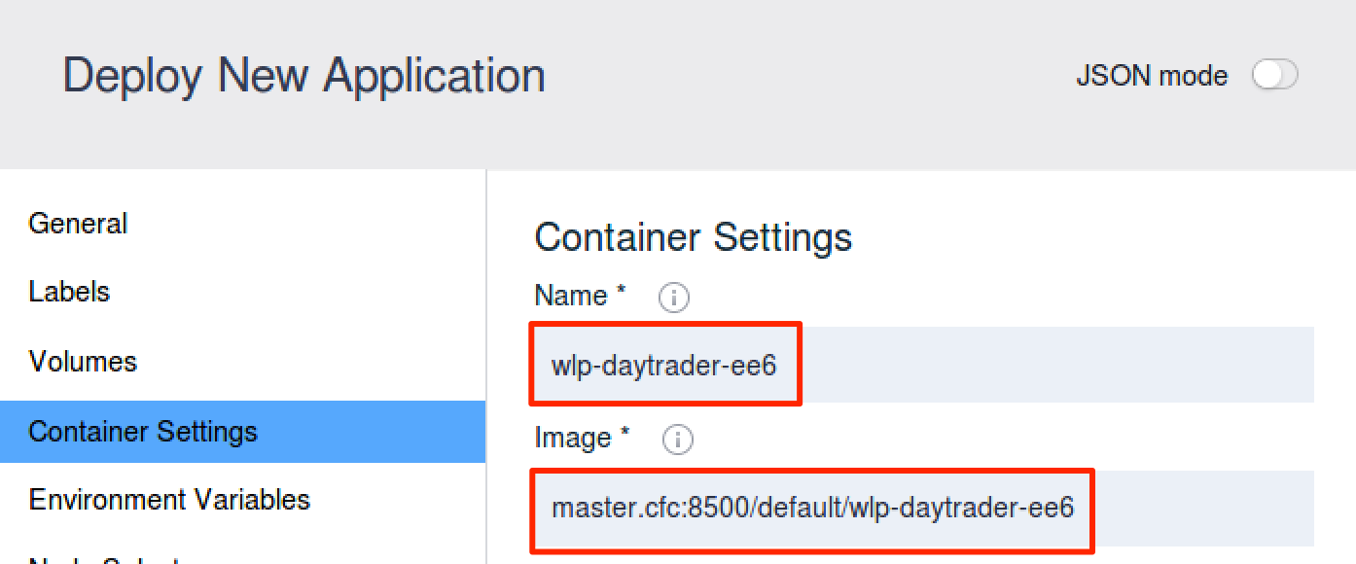
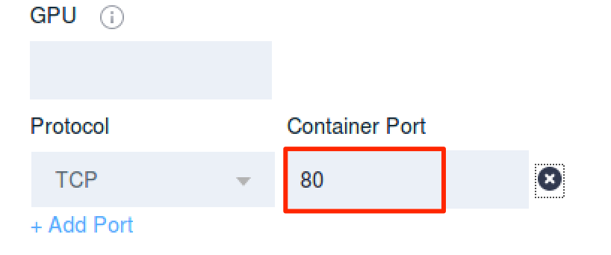
Deploying a Docker image to IBM Cloud Private (4 of 8)
Step 6: Enter application deployment information
Tab: General
Field:
Name – name of the application
Tab: Container Settings
Fields:
Name – name of the container
Image – name of the image (must match image tag name)
Protocol & Container Port – Liberty server port to be exposed by the container

Slide 23
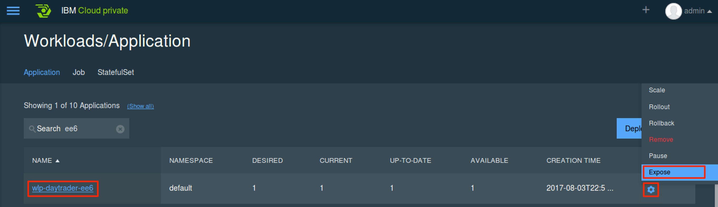
Deploying a Docker image to IBM Cloud Private (5 of 8)
Step 7: Expose deployed application for external access
Go to Menu → Workloads → Applications
Click to Settings → Expose to create a service to expose application for external access

Slide 24
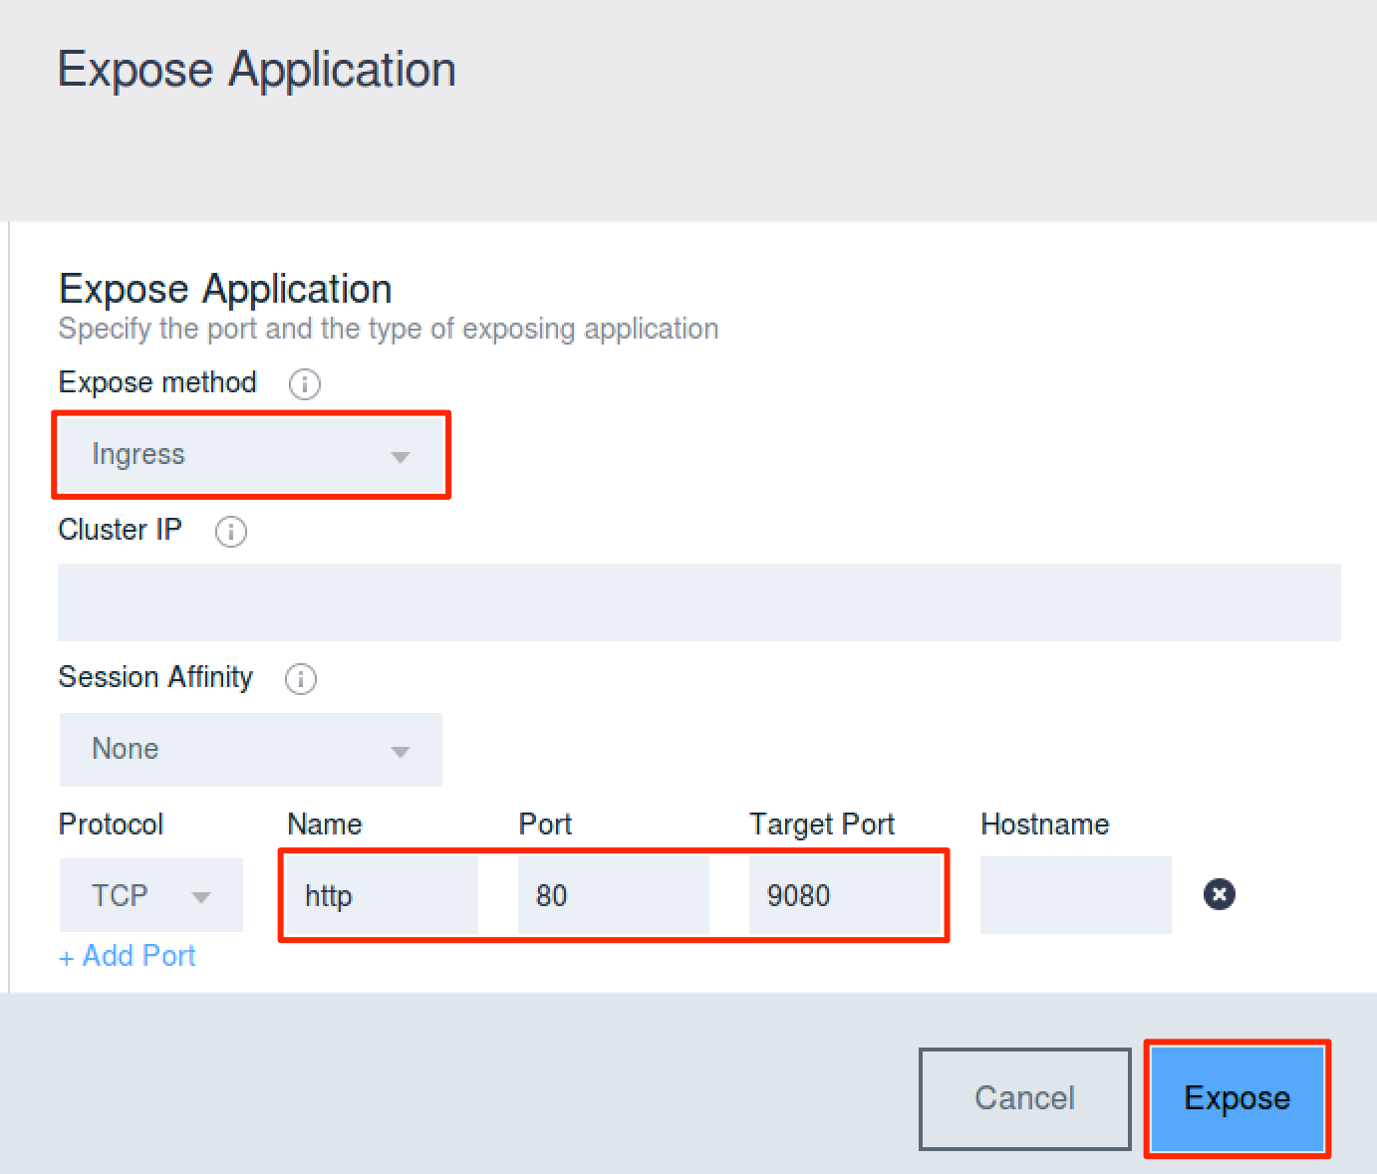
Deploying a Docker image to IBM Cloud Private (6 of 8)
Step 8: Enter expose service information
Expose method:
ClusterIP – Exposes the service on a cluster-internal IP. Service only reachable from within the cluster. (default).
NodePort – Exposes the service on each Node’s IP at a static port (the NodePort). You’ll be able to contact the NodePort service, from outside the cluster, by requesting <NodeIP>:<NodePort>.
Ingress – Exposes the service on IP and PORT assigned based on default ingress controller configured for the environment.
Protocol, Name, Port, & Target Port: Source and target port on the container to be exposed.
Click Expose to create a service to expose the application.

Slide 25
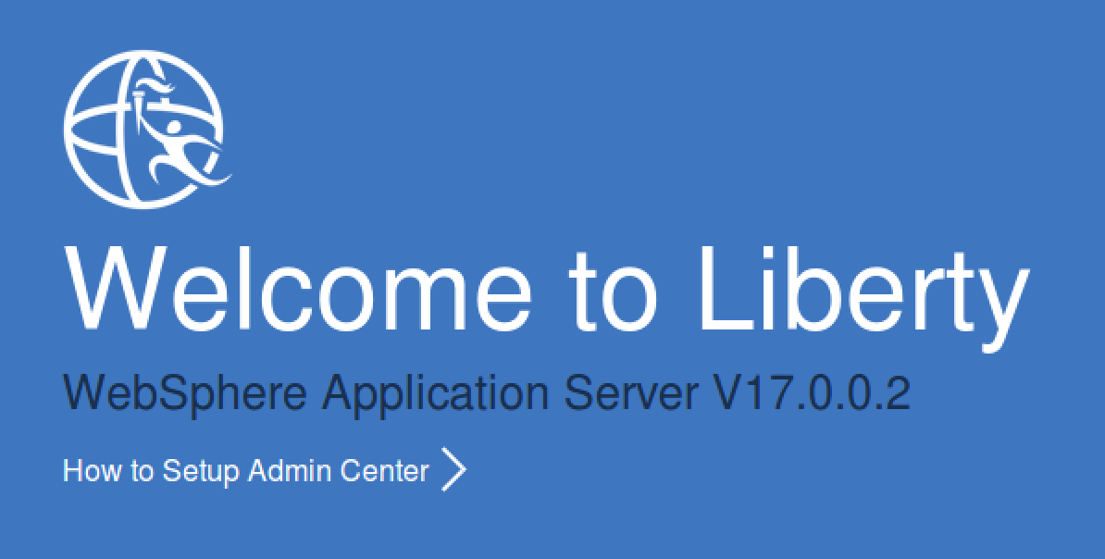
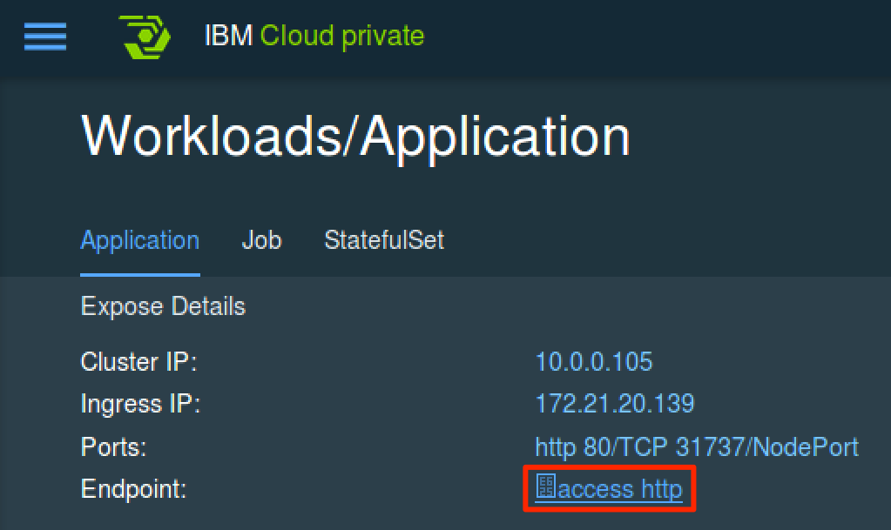
Deploying a Docker image to IBM Cloud Private (7 of 8)
Step 9: Verify application accessibility
Go to Menu → Workloads → Applications and click the application from the list
Click the access http link to open the Liberty server root context. Append application specific context path to access deployed application.

Slide 26
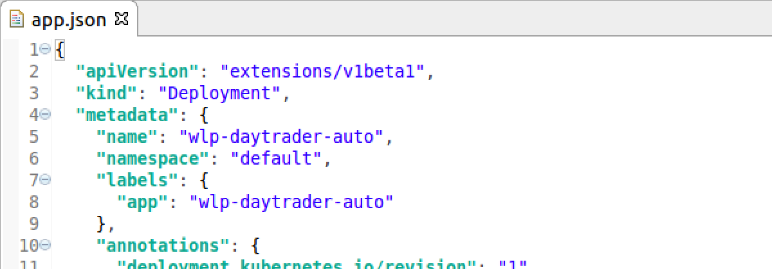
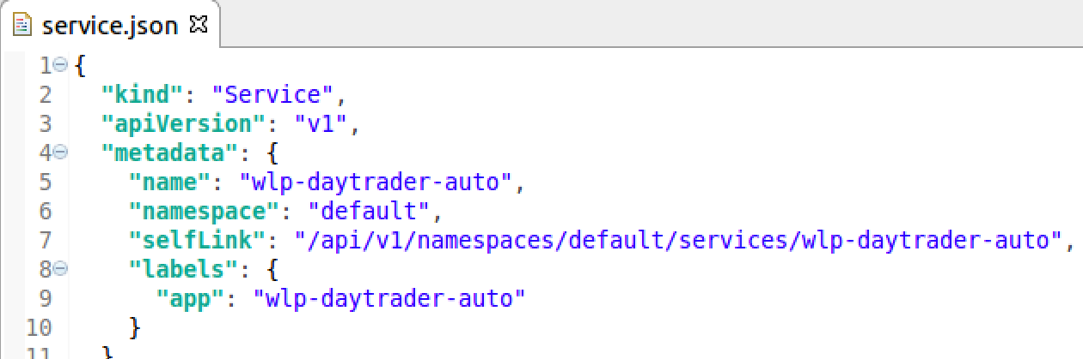
Deploying a Docker image to IBM Cloud Private (8 of 8)
Alternate Step: Deploy application using kubectl CLI
kubectl create -f app.json
The Kubernetes command line interface (CLI) provides extensive deployment and management options
The CLI deployment and management option supports scripting and automation
Alternate Step: Expose application using kubectl CLI
kubectl create -f service.json

